Slide 1
Lincoln Park UBF Membership Class #7
UBF

Slide 2
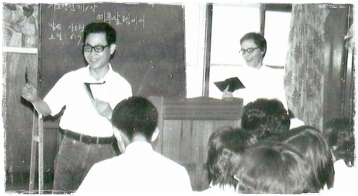
Samuel Lee, Sarah Barry

Slide 3
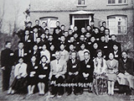
First UBF conference

Slide 4
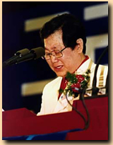
Samuel Lee

Slide 5
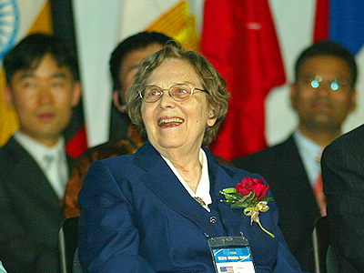
Sarah Barry

Slide 6
UBF traits
Evangelistic
Inductive Bible study
Morning devotions (Daily Bread)
Discipleship
Fellowship meetings, conferences
World Missions through self-supporting missionaries
Giving

Slide 7
Scope of UBF ministry today
120 local chapters in North America
About 1,600 active missionaries in over 80 countries
Largest ministry in South Korea
Active in Mexico, Venezuela, Nigeria, South Africa, Uganda, Kenya, Zimbabwe, Philippines, Indonesia, Mongolia, Hong Kong, Taiwan, Russia, Germany and United Kingdom

Slide 8
UBF
Registered with the U.S. government as a church, and as a 501(c)(3) non-profit organization
Registered with the State of Illinois as a tax exempt organization
Local chapters in the U.S. are also registered in their state as a tax exempt organization

Slide 9
Memberships
MissioNexus: collaboration of ministries in North America engaged in carrying out the Great Commission
ECFA: Evangelical Council on Financial Accountability
NAE: National Association of Evangelicals
Staff studied at following theological seminaries & Bible schools: Trinity Evangelical Divinity School (Deerfield, IL); Wheaton College (Wheaton, IL); Gordon-Conwell (Boston, MA); Fuller (Pasadena, CA); Capital Bible Seminary (Greenbelt, MD); Midwest Univeristy (St. Louis, MO)

Slide 10
Operating Budget, Assets
Annual operating budget of approx. $2 million
Total assets of about $13 million
See details at: http://www.ecfa.org/MemberProfile.aspx?ID=20401

