Slide 1
Introduction to
1 John
And this is his command:
to believe in the name of his Son, Jesus Christ,
and to love one another
as he commanded us.
1 John 3:23

Slide 2
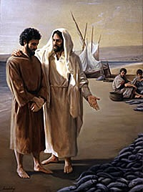
Author
John, son of Zebedee (Mk 1:19-20)
A fisherman, one of the three of Jesus'
inner circle together with James and Peter
"the one whom Jesus loved" (Jn 13:23)
wrote 1 John in similar style to John's gospel:
-simple Greek
-contrasts: light & darkness, life & death,
truth & lies, love & hate
-wrote with authority

Slide 3
Date and Recipients
between AD 85 and 95 (John was elderly)
1 Jn 2:12-14, 19; 3:1; 5:13 make it clear that this letter was addressed to believers
The letter does not indicate who the recipients were or where they lived, but it is clear that he personally knows them
Earliest confirmed use of 1 John was in the Roman province of Asia where Ephesus was located
John ministered in various churches scattered throughout that province of Asia

Slide 4
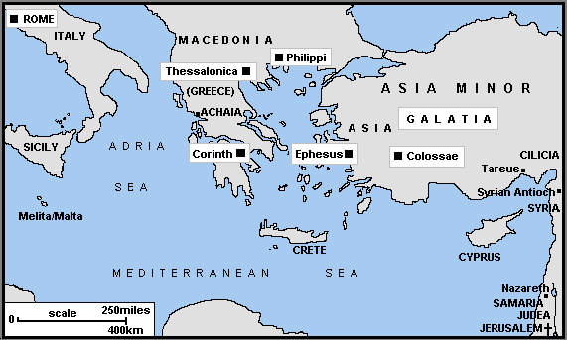

Slide 5
Gnosticism
heresy of the first two centuries of the church
central teaching was that spirit is good and matter is evil
5 important errors followed:
the human body, which is matter, is evil
salvation is the escape from the body, achieved not by faith in Christ, but by special knowledge (gnosis is "knowledge" in Greek)
Jesus' true humanity was denied
since the body was considered evil, it was to be treated harshly: asceticism
paradoxically, this sometimes led to licentiousness--it is "matter" that is evil, so breaking God's law was of no moral consequence

Slide 6
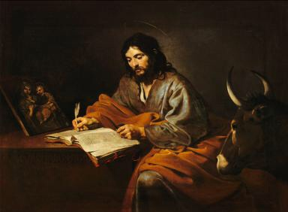
Occasion and Purpose
former members of John's churches had abandoned the faith (2:18-19) causing doubt in the churches
John wrote 1 John with two basic purposes in mind:
to expose the false teachers (2:26)
to give believers assurance of salvation (5:13)

Slide 7
Occasion and Purpose
John struck at the total lack of morality of the Gnostic teachers (3:8-10)
he gave eyewitness testimony to the humanity of Jesus (1:3)

Slide 8
John set forth key tests of authentic Christian faith
(indispensable hallmarks of true believers)
1. belief that Jesus is the Messiah, the Son of God
(2:18-28; 3:23-4:6; 4:14-15; 5:1,5)
And this is his command: to believe in the name of his Son, Jesus Christ,
and to love one another as he commanded us.
1 John 3:23
Who is it that overcomes the world?
Only the one who believes that Jesus is the Son of God.
1 John 5:5

Slide 9
John set forth key tests of authentic Christian faith
(indispensable hallmarks of true believers):
obedience to Christ's commands
(1:5-2:6; 2:29-3:10; 3:22-24; 5:4-21)
We know that we have come to know him if we keep his commands.
1 John 2:3
The one who keeps God’s commands lives in him, and he in them.
And this is how we know that he lives in us:
We know it by the Spirit he gave us.
1 John 3:24

Slide 10
John set forth key tests of authentic Christian faith
(indispensable hallmarks of true believers):
love for brothers and sisters in Christ
(2:7-17; 3:10-24; 4:7-5:3)
Dear friends, let us love one another, for love comes from God.
Everyone who loves has been born of God and knows God.
Whoever does not love does not know God, because God is love.
1 John 4:7,8

Slide 11
Outline
I. Introduction: The Reality of the Incarnation (1:1-4)
II. The Christian Life as Fellowship with the Father and the Son
(1:5-2:28)
A. Ethical Tests of Fellowship (1:5-2:11)
1. Moral likeness (1:5-7)
2. Confession of sin (1:8-2:22)
3. Obedience (2:3-6)
4. Love for fellow believers (2:7-11)
B. Two Digressions (2:12-17)
C. Christological Test of Fellowship (2:18-28)
1. Contrast: apostates versus believers (2:18-21)
2. Person of Christ: the crux of the test (2:22-23)
3. Persistent belief: key to continuing fellowship (2:24-28)
The Christian Life as Divine Sonship (2:29-4:6)
A. Ethical Tests of Sonship (2:29-3:24)
1. Righteousness (2:29-3:10a)
2. Love (3:10b-24)

Slide 12
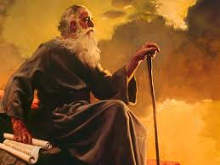
Outline
The Chistian Life as an Integration of the Ethical and Christological (4:7-5:12)
A. The Ethical Test: Love (4:7-5:5)
1. The source of love (4:7-16)
2. The fruit of love (4:17-19)
3. The relationship of love for God and love for one's fellow Christians (4:20-5:1)
4. Obedience: the evidence of love for God's children (5:2-5)
B. The Christological Test (5:6-12)
V. Conclusion: Great Christian Certainties (5:13-21)

Slide 13
LPUBF 1 John study schedule
5/3 – 1 Jn 1:1-4 Our Fellowship
5/10 – 1 Jn 1:5-2:2 Walk In the Light
5/17 – 1 John 2:3-11 Loving Is Living In the Light
5/24 – 1 John 2:12-17 Do Not Love the World
5/31 – 1 John 2:18-27 Remain In Him
6/7 – 1 John 2:28-3:10
6/14 – 1 John 3:11-24
6/21 – 1 John 4:1-6
6/28 – 1 John 4: 7-21
7/5 – 1 John 5:1-12
7/12 – 1 John 5:13-21

